Slide 1


Eco-Monitor
(Prototype)
An Artificial
Green-Thumb
Created by Jake Sheckler

Slide 2




Overview
Some plants are specific in their needs, like:
Orchids
Gardenias
Lilies
Camellias
And so many more!
But by using sensors, we can better monitor and fine tune these laborious plants!
For the sensors have tangible value, I2C & UART are utilized for a display and in addition, Interrupts to cycle the display

Slide 3
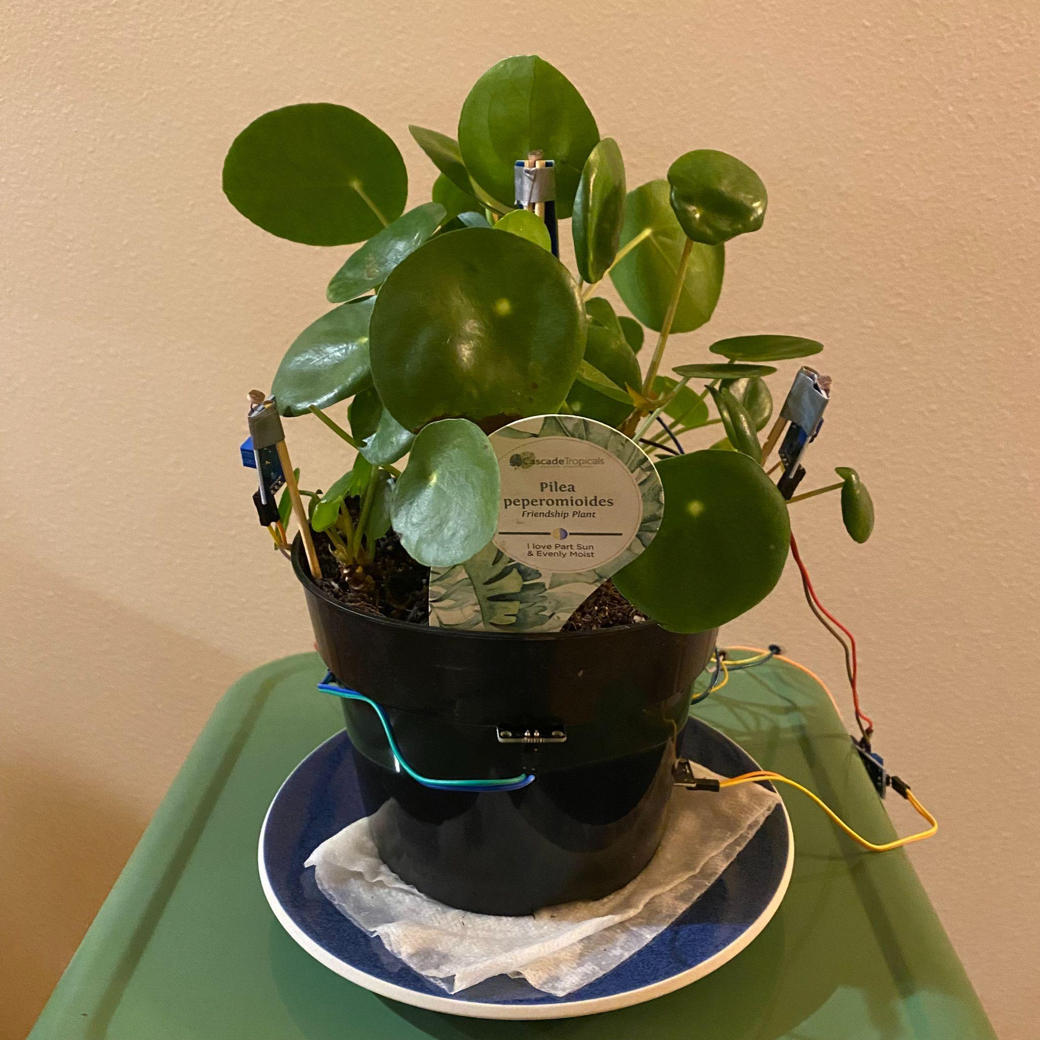
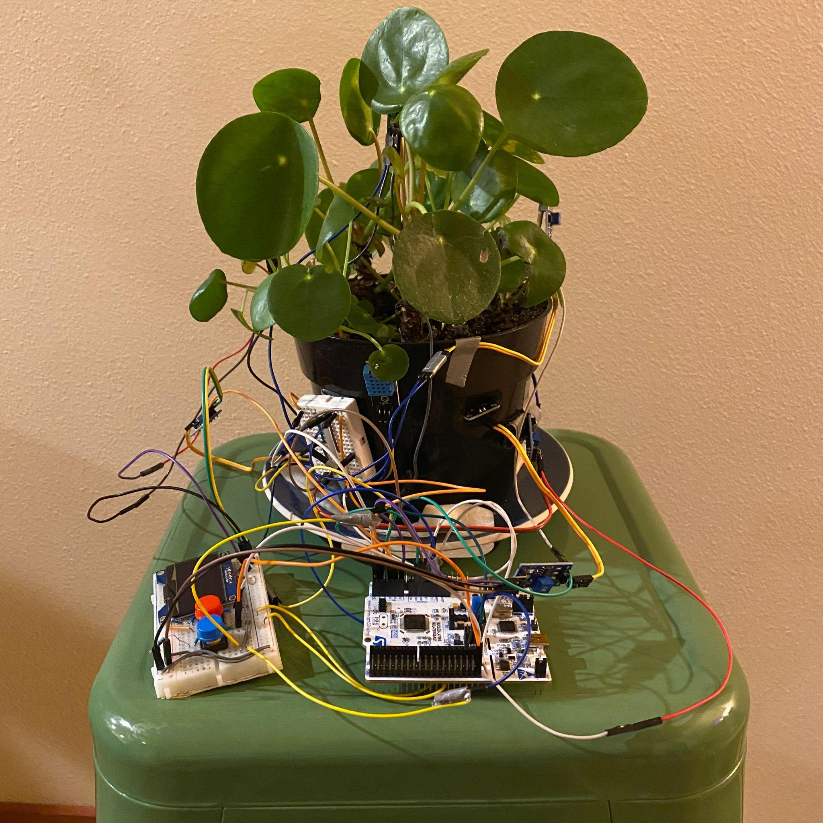
Hardware & Peripherals
Pilea peperomioides or
Chinese Money Plant or
Friendship Plant :D
Work in the Front
Party in the Back
The board on the plant is used for power
And the second board is for power, the display and user input

Slide 4
Per
Hardware & Peripherals
Hardware:
STM32L476
DHT11 sensor.
LM393-based soil and light sensors.
SSD1306 OLED display (connected via I2C).
Buttons for Interrupts
Peripherals:
DHT11, LM393’s and buttons all configured using GPIOA and GPIOC.
I2C and UART are to be used for the SSD1306 display
GPIOA Set up:
PA0, 1 and 13 are for 3 LM393 Soil sensors
PA4 is for DHT11 Humidity & Temp :)
GPIOC Set up:
PC0, 2 and 3 are used for 3 LM393 Light Sensors
PC8 and 9 are for Interrupts

Slide 5
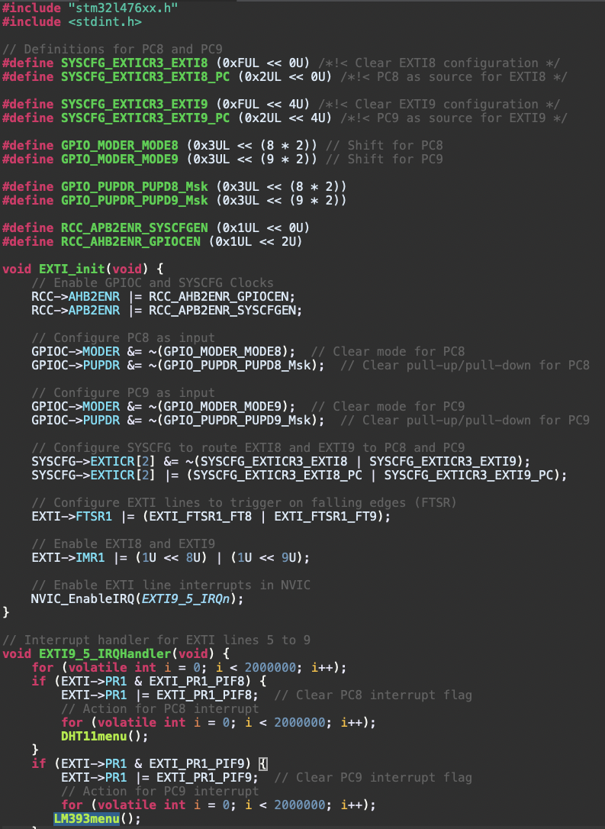
Per
System design & Config
Interrupt Code:
Interrupts:
I2C& UART:
The interrupts are used for changing the display!
Same code from the Lab 3 Template
{
The red button is for checking on the soil moisture status
Setting PC8 & 9 as Interrupt
{
If PC8, DHT11 Menu
{
If PC9, LM393 Menu

Slide 6
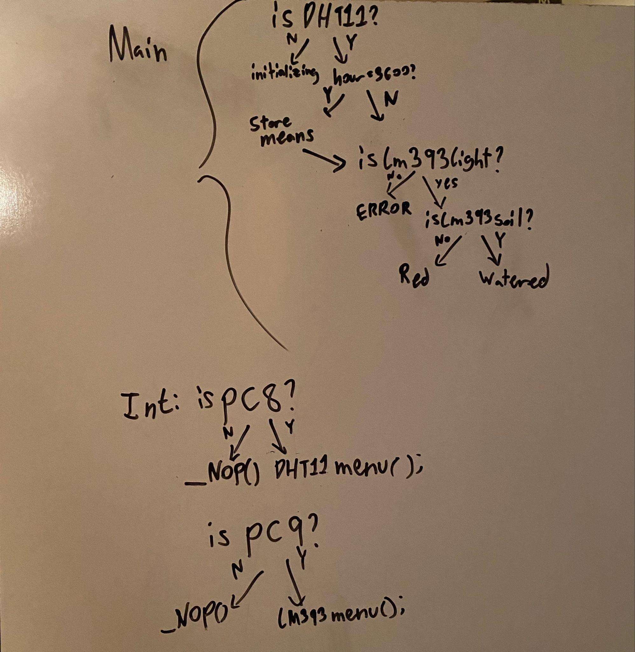
Per
System design & Config cont.
General use:
-HAL_Init();
-SystemClock_Config(); -MX_USART2_UART_Init(); -MX_I2C1_Init();
-ssd1306_Init();
-GPIO_Init();
-EXTI_init();
-delay_us();
Function List (By use)
DHT11:
-set_pin_output();
-set_pin_input();
-DHT11_Read(); *
-DHT11menu(); *
Many are self-explanatory
LM393:
-LM393Mainsetup();
-Read_LM393Soil();
-Read_LM393Light();
-LM393menu(); *
The * are explained further in

Slide 7
Per
Code Explanation:
First, the code checks if the DHT11 is sending data back
If the data is being sent, the code then goes through taking the LM393 Data
In between taking the data, the program is logging the temp & humidity values
Since data is being logged 3600 times in 1 hour (every second), if a counter hits 3600, the code will take the average and log that into a daily average
If a soil sensor is off, the display will show that too (in demo)
If a Light sensor is off, the display will show that (more in the demo)
After that, the counter resets :)
Interrupts!
If the red button is pressed, the display will show what’s going on with the soil sensors (shown in demo)
Displays:
Main display format:
-Humidity level
-Temp Level
-Light Level
-Soil Moisture Level
Blue Display:
-Hourly Humidity
-Hourly Temp
-Daily Humidity
-Daily Temp
If the blue button is pressed, the hourly and daily (within 24 hrs) values for the temp and humidity :)
Red display only displays moisture information

Slide 8
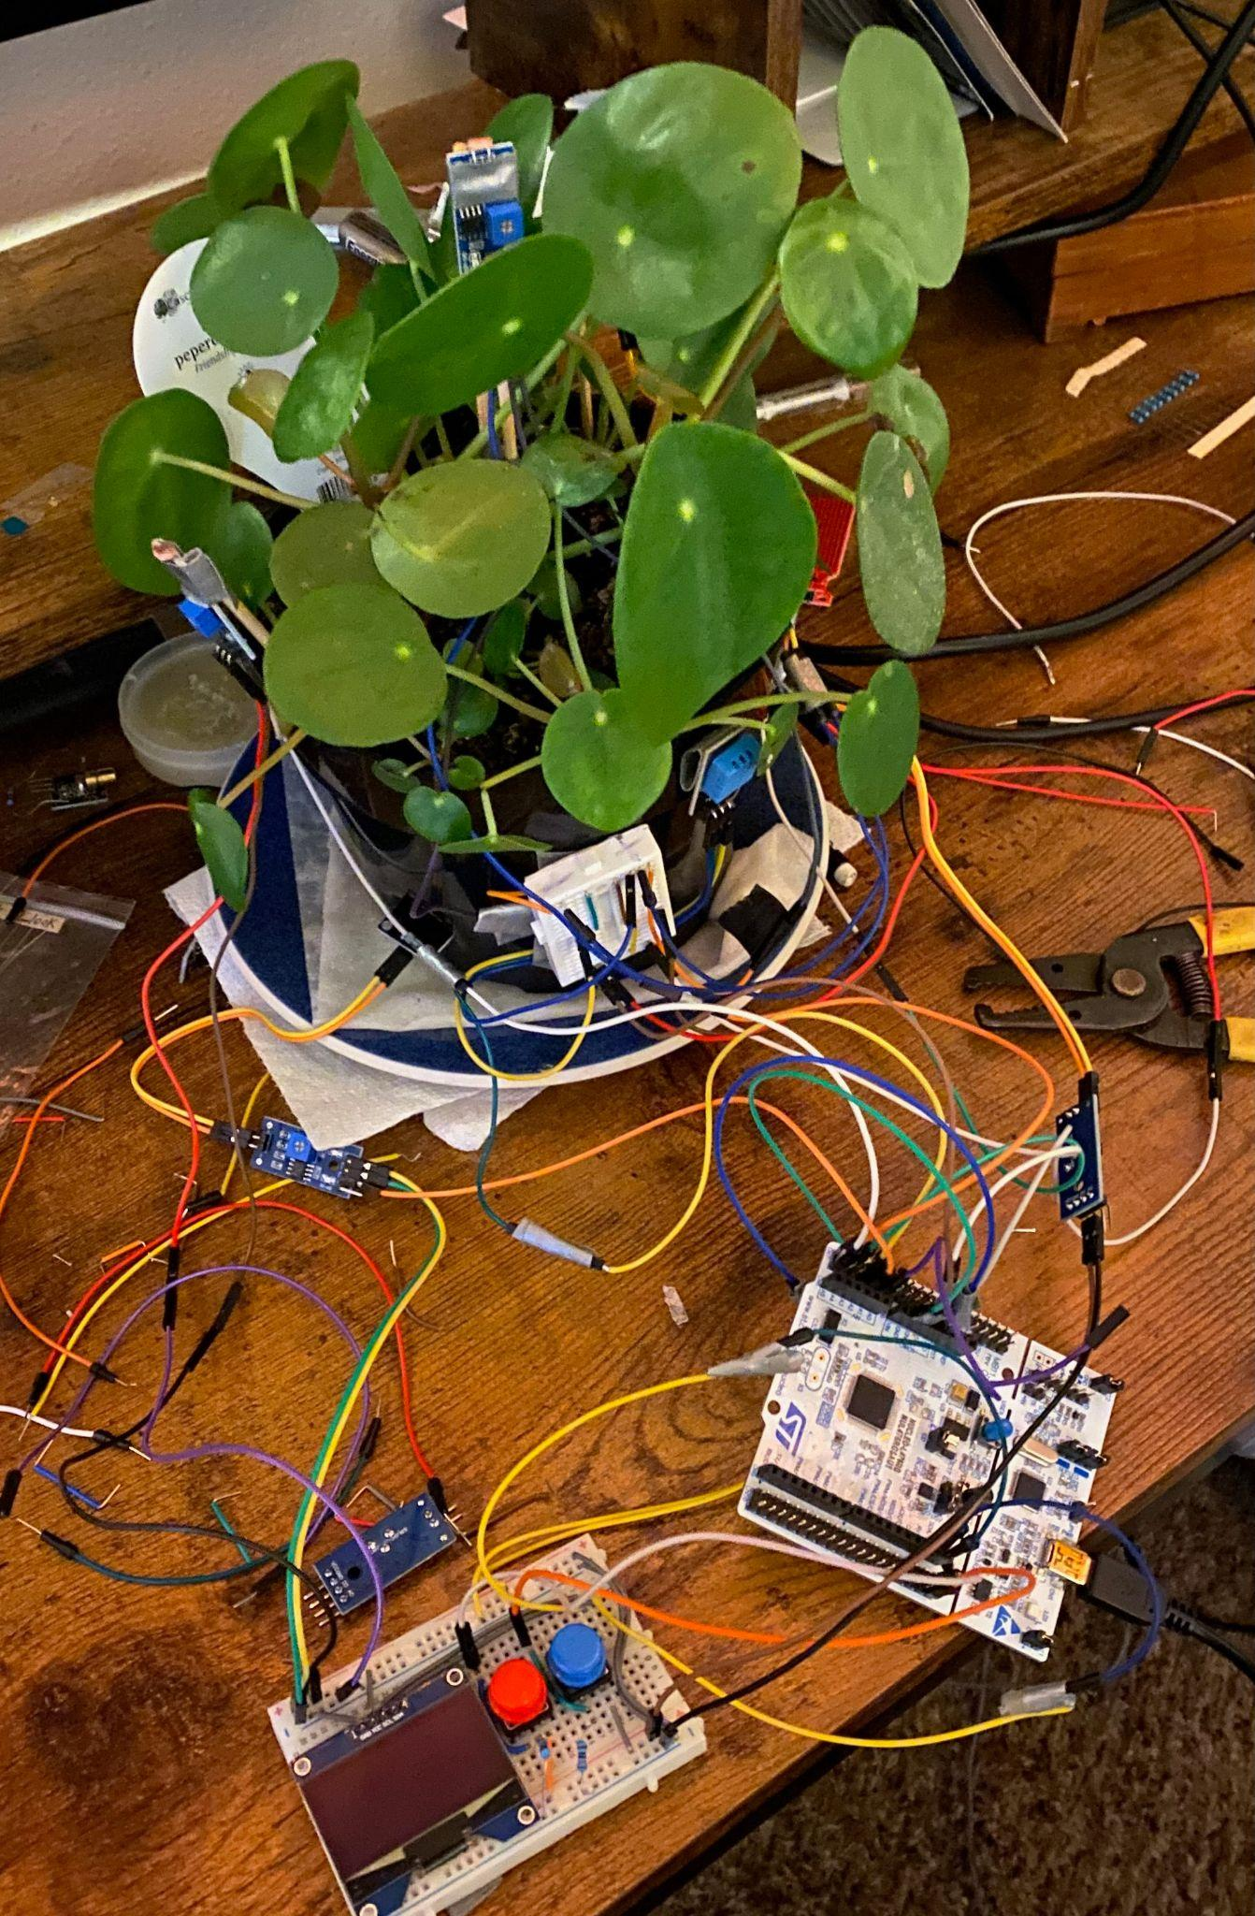
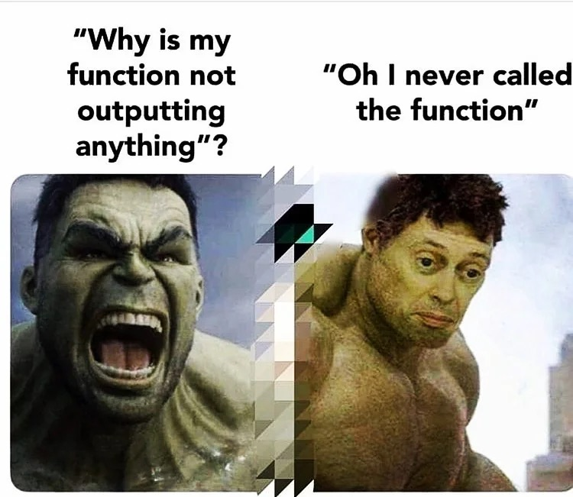
Per
Challenges
(There were many)
The second largest problem is that when working the problem, I would end up nesting my code too much and it would become knotted when I try to separate out.
Frequent problems:
Forever while loops (DHT11Read)
Memory? Never heard of it
Display in discord
Using averages to find averages
Problem-solving on the fly *
PowerPoint Production
Setting the Sensors
When doing the final wiring, I ran into the same problem.
If I were to label my biggest problem, it would be construction of the PowerPoint
Here was the first attempt.

Slide 9
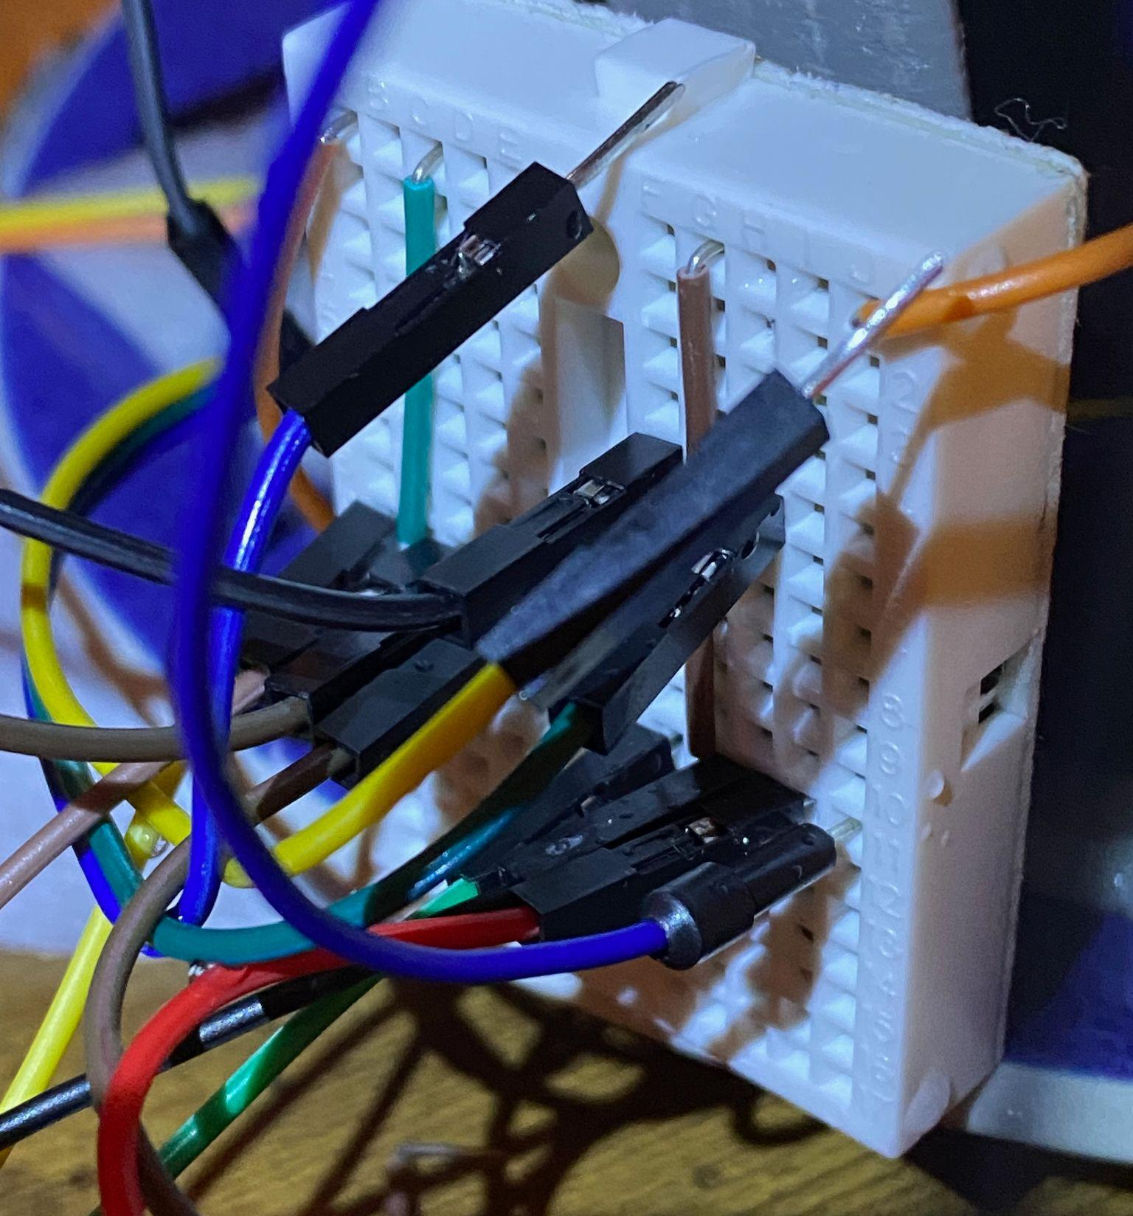

Per
Solutions
(There were also many)
Frequent Solutions:
(Not plugging everything into one small breadboard)
Forever while loops –> Timeouts
Memory –> Chunks
Sensors not displaying in unison? –> set the display to the slowest sensor
Don’t “knot” the code
Taking too long to make the presentation? –> stop adding new things to the project :D
Checklist:
Forever while loops (DHT11Read)
Memory? Never heard of it
Display in discord
Using averages to find averages
Problem-solving on the fly
PowerPoint Production

Slide 10
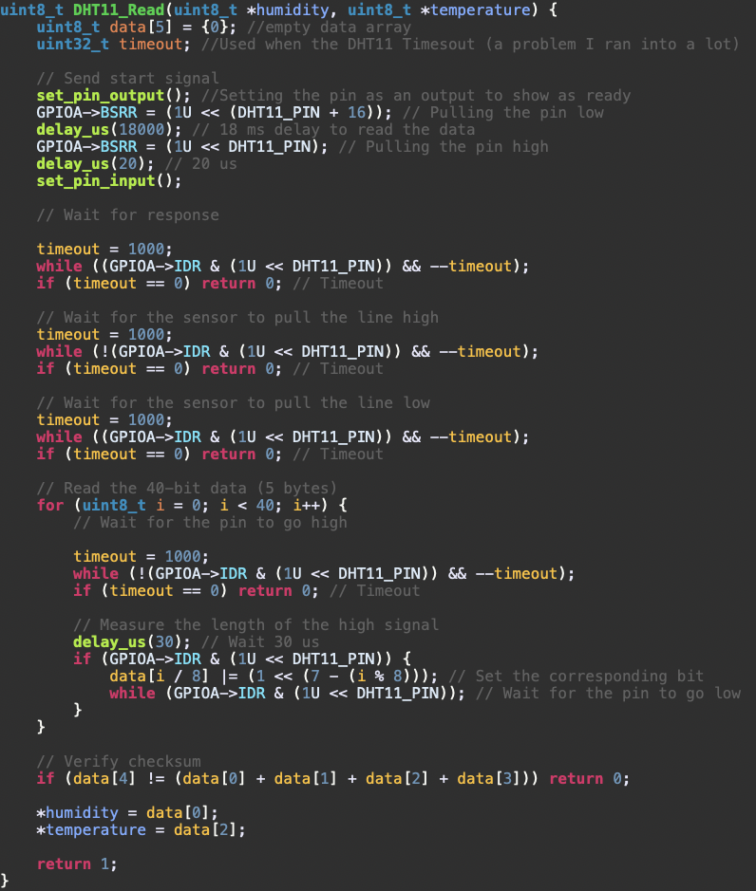
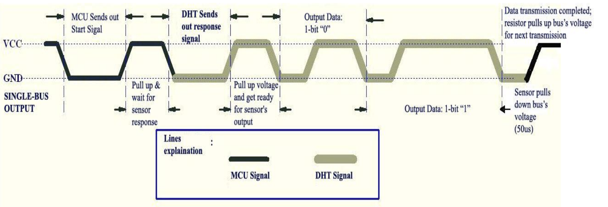
Per
Per
System design & Config cont.
Code Explanation:
DHT11 Read:
As you can see, I ended up using while timeouts to circumvent the first few seconds of startup that cause an infinite wait
I followed the DHT11 data sheet & followed the Overall Communication Process (5.1)
The checksum is important for data validation and error detection

Slide 11
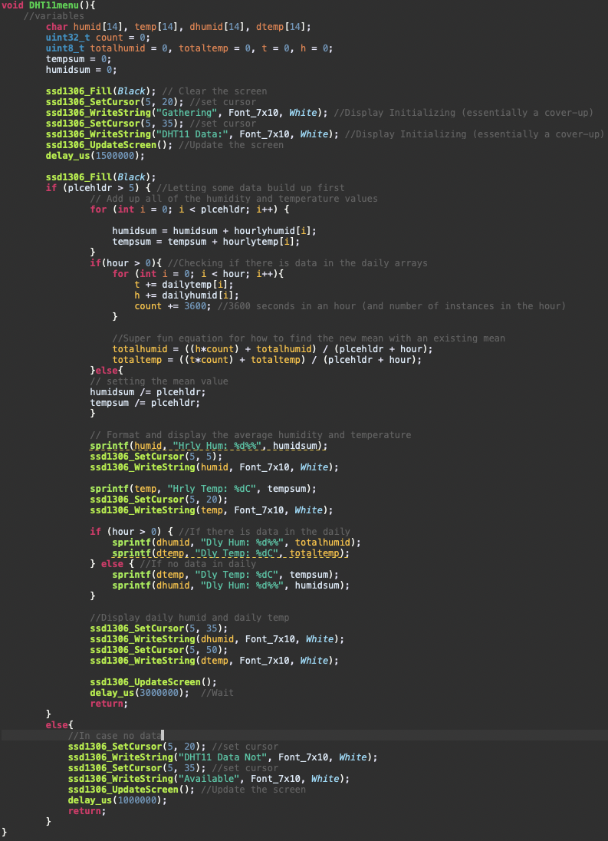
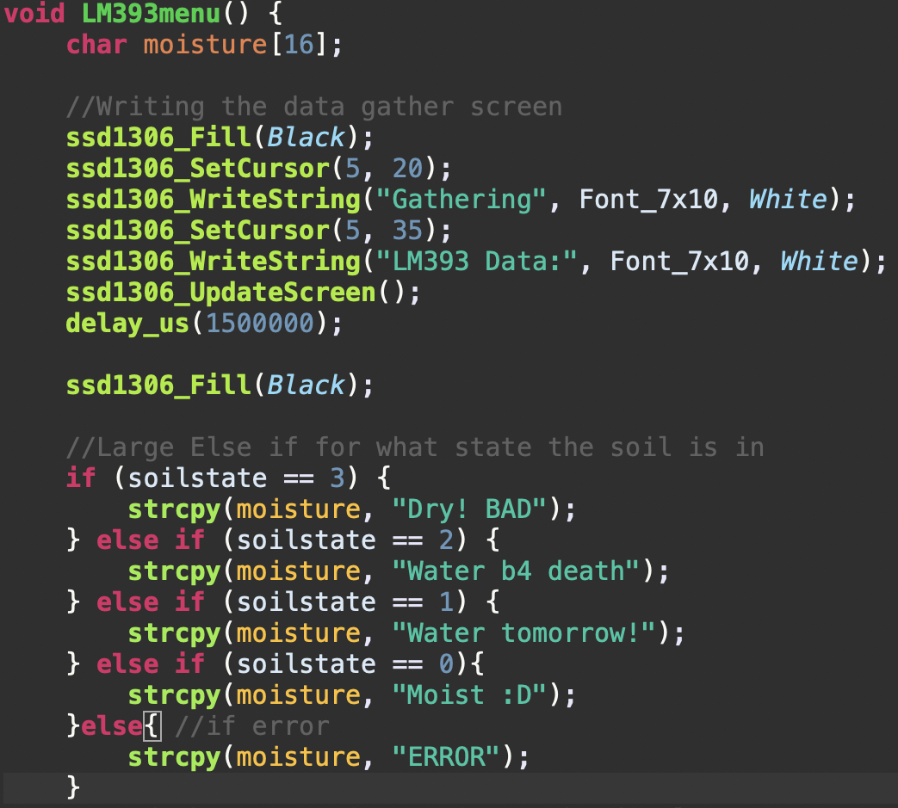

Per
Per
System design & Config cont.
Code Explanation:
DHT11 & LM393 Menu:
Mean equation:

Slide 12
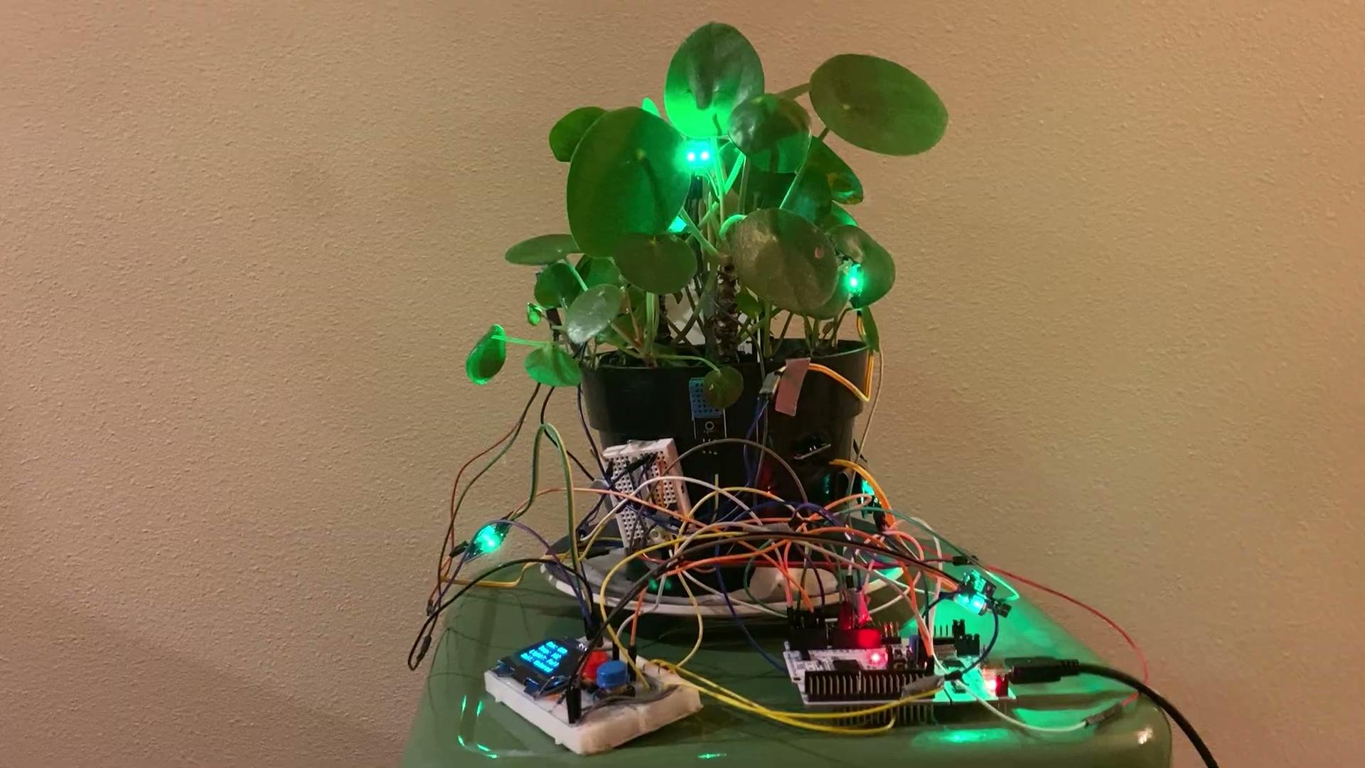
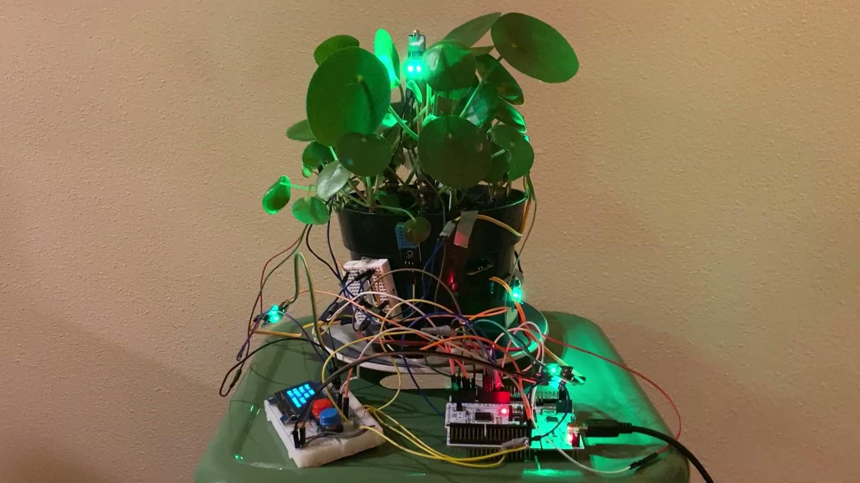
Per
Demo
Video 2 Showing red button, all lights & all moisture working
Video 1 Showing blue button & not ready blue button

Slide 13
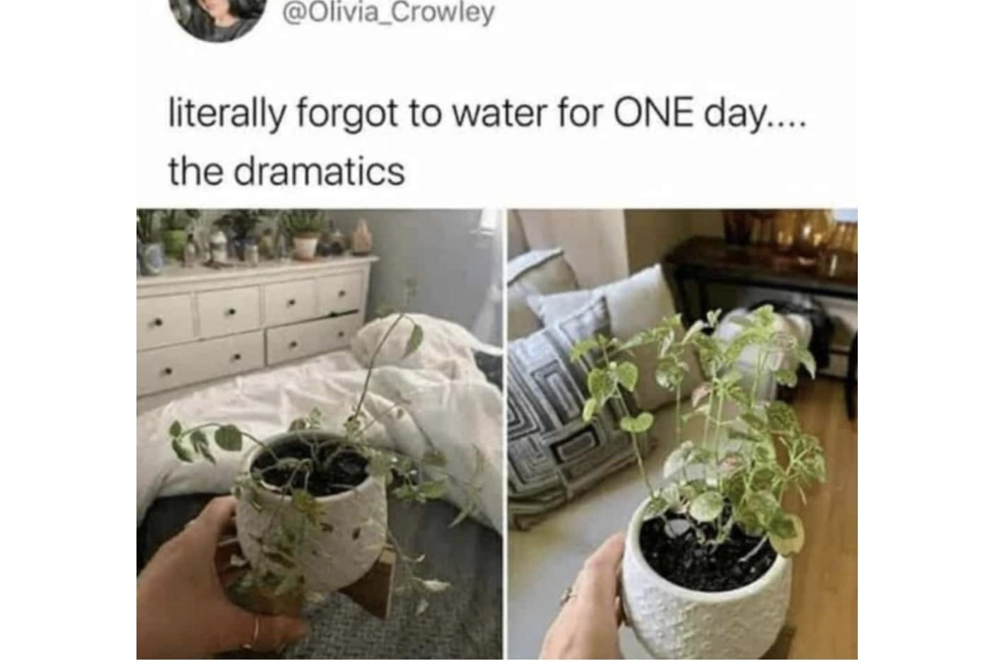
Per
Conclusion
Lost additions:
Light Timer
Attention Buzzer
External Data Storage
Analog LM393 Sensors
Self Watering
Soil Evaporation Rate
Wireless signaling (pipe dream)
Direct Application:
Automatic Greenhouse
Precision farming
Indirect Application:
Air Quality & Climate Research
HVAC Optimization
Reforestation (pipe dream)
Learning Takeaways:
Interrupts are very fun to use
I am not built for using the ADC peripheral
Takeaways:
Bare-metal coding is arduous, but rewarding.
Manually reading sensor data isn’t as hard one would think

Slide 14
Per
References
DHT11 Sensor Datasheet
https://www.mouser.com/datasheet/2/758/DHT11-Technical-Data-Sheet-Translated-Version-1143054.pdf?srsltid=AfmBOoqBY5_no5Y_ZJEITtdm8gq0sbssLYjlUH0J9E6k2-AeHu0QG0fp
Plant help
https://crazyplantguy.com/pilea-peperomioides

